Slide 1
Computer Science 20
Conditions, variables, and Loops Self-check

Slide 2
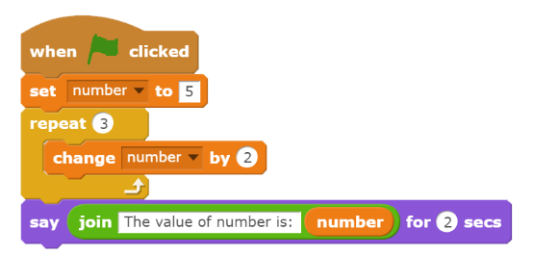
When the following script runs, what will the sprite say the value of number is?
Notes:
11

Slide 3
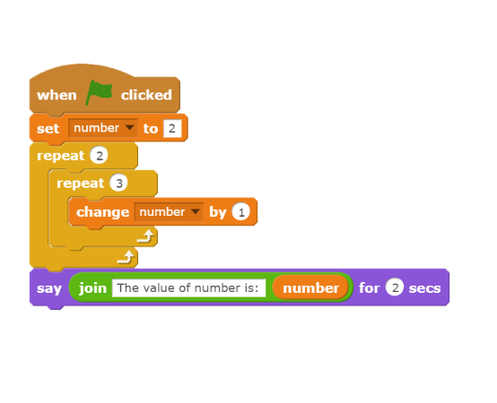
When the following script runs, what will the sprite say the value of number is?
Notes:
8

Slide 4
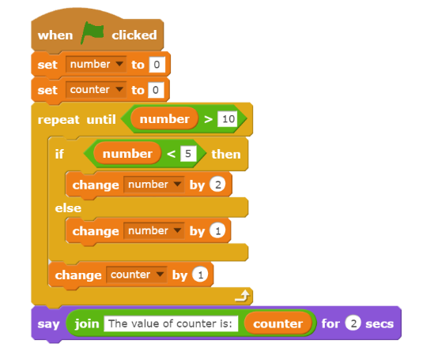
Number Counter
0 0
2 1
4 2
6 3
7 4
8 5
9 6
10 7
11 8
When the following script runs, what will the sprite say the value of counter is?

Slide 5
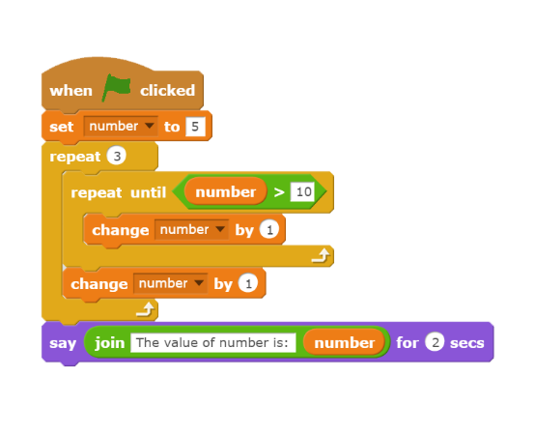
When the following script runs, what will the sprite say the value of number is?
Notes:
14

